Slide 1
Learning to Learn
How to find, learn, and master new skills, languages, libraries, and frameworks

Slide 2

Lara Newsom
Source Allies Software Consultant
Twitter - @laranerdsom
Github - https://github.com/lnewsom
Linkedin

Slide 3
Background
B.S. Botany - Iowa State University: 1997
B.F.A. Painting - University of Iowa: 1999
M.F.A. Art/Integrated Media - California Institute of Arts: 2003
Graphic/Web Design Contractor - Newsom Design: Los Angeles: 2003-2007
Handmade Pretties (Crafting Business) - Los Angeles/Des Moines: 2001-2018
Freelance Graphic/Web Design - Des Moines, Iowa: 2007-2014
Software Developer - Advantage 2000, St Louis, MO: 2014-2018

Slide 4


Slide 5
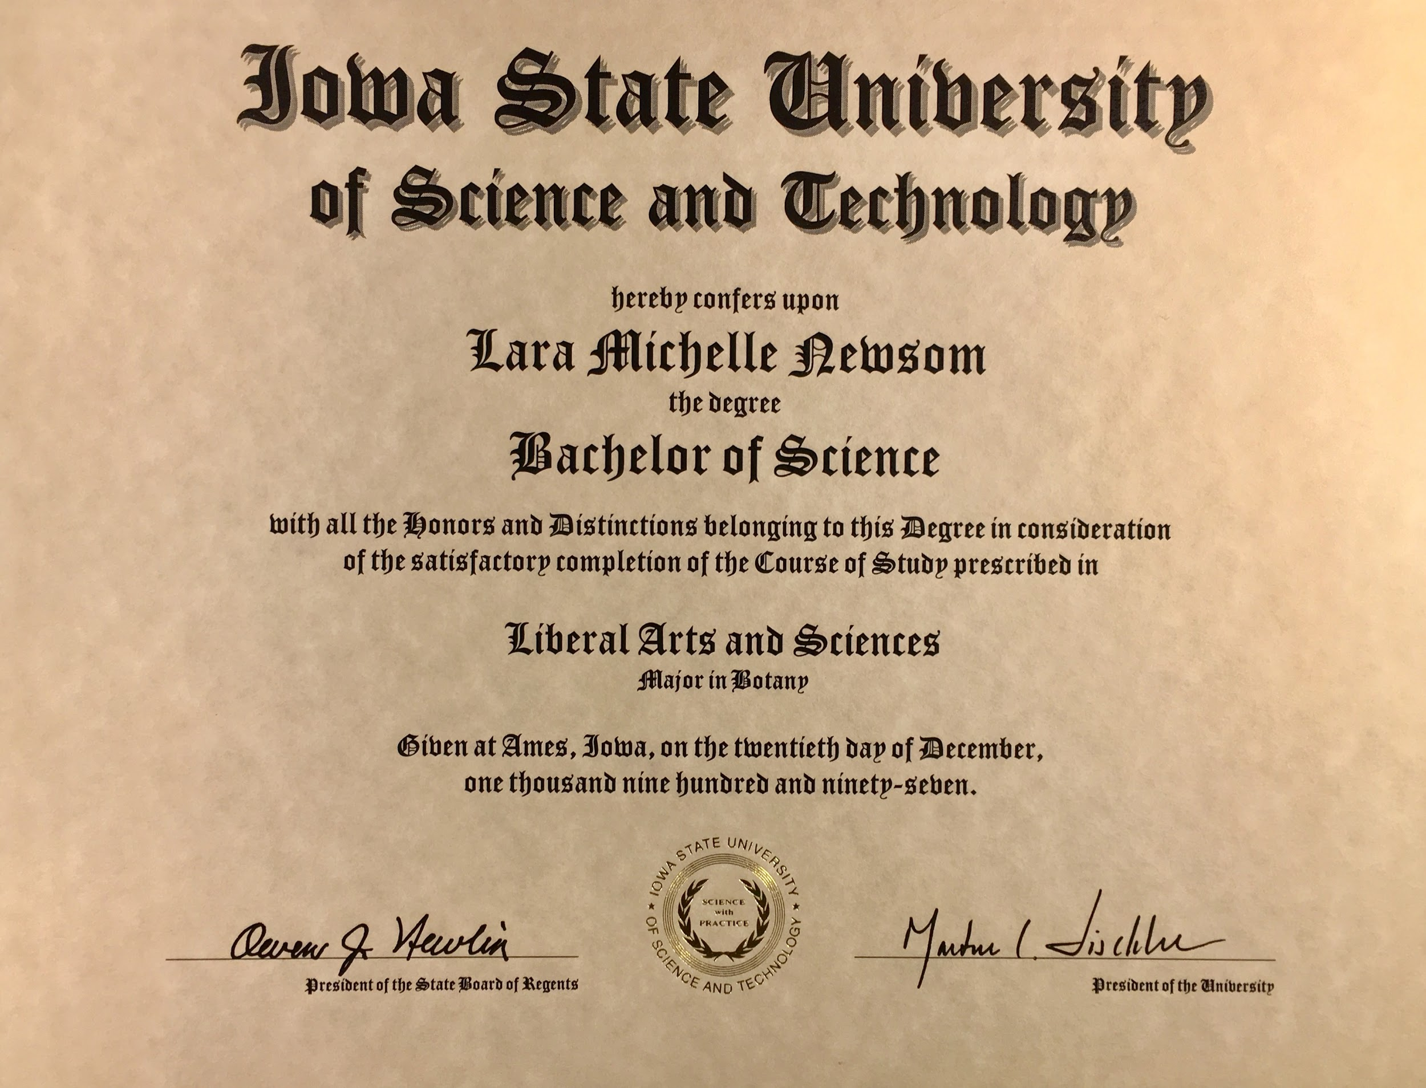

Slide 6


Slide 7
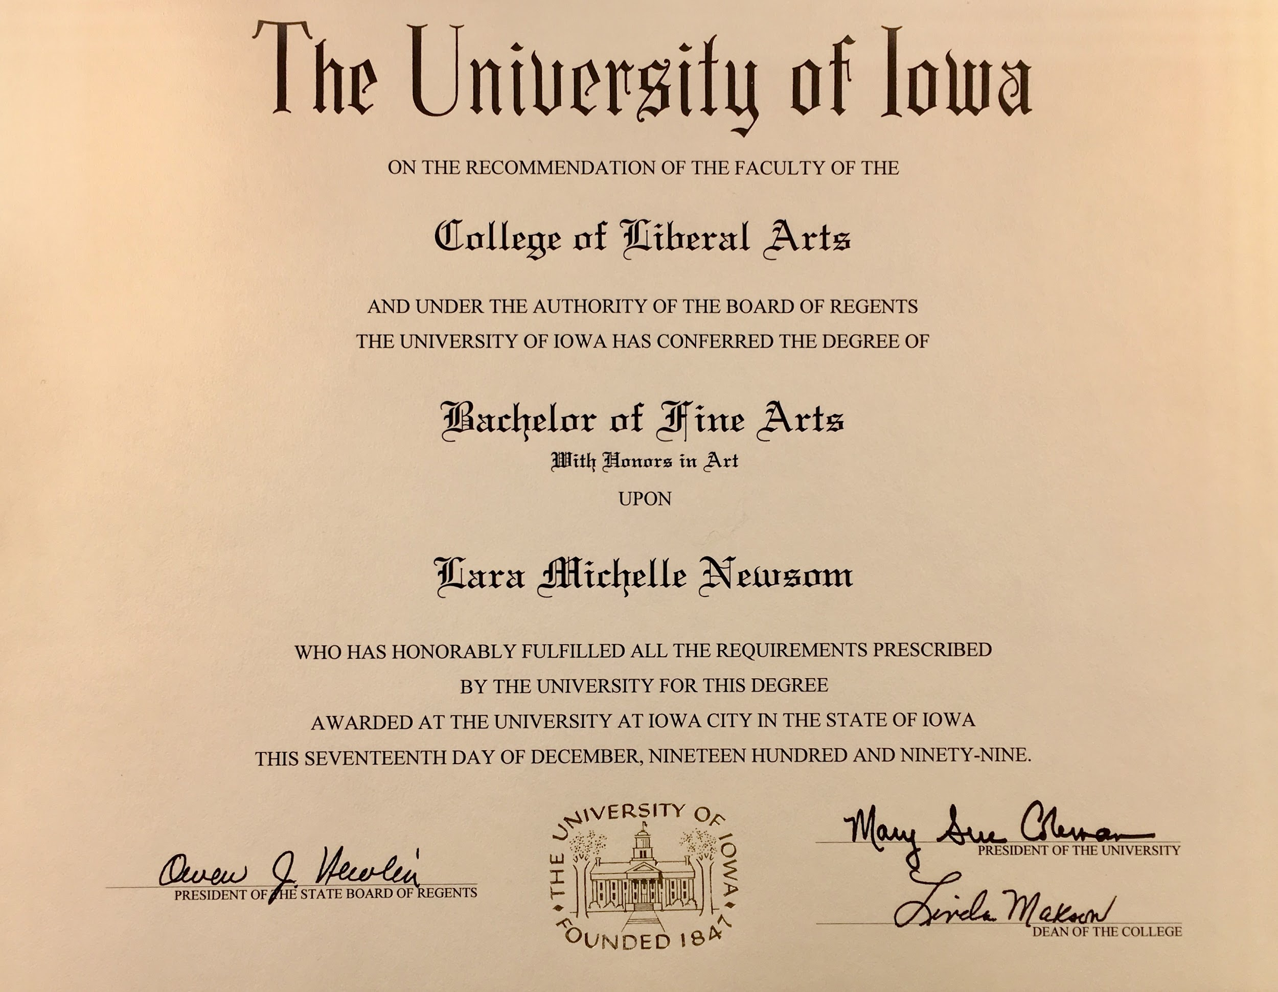

Slide 8
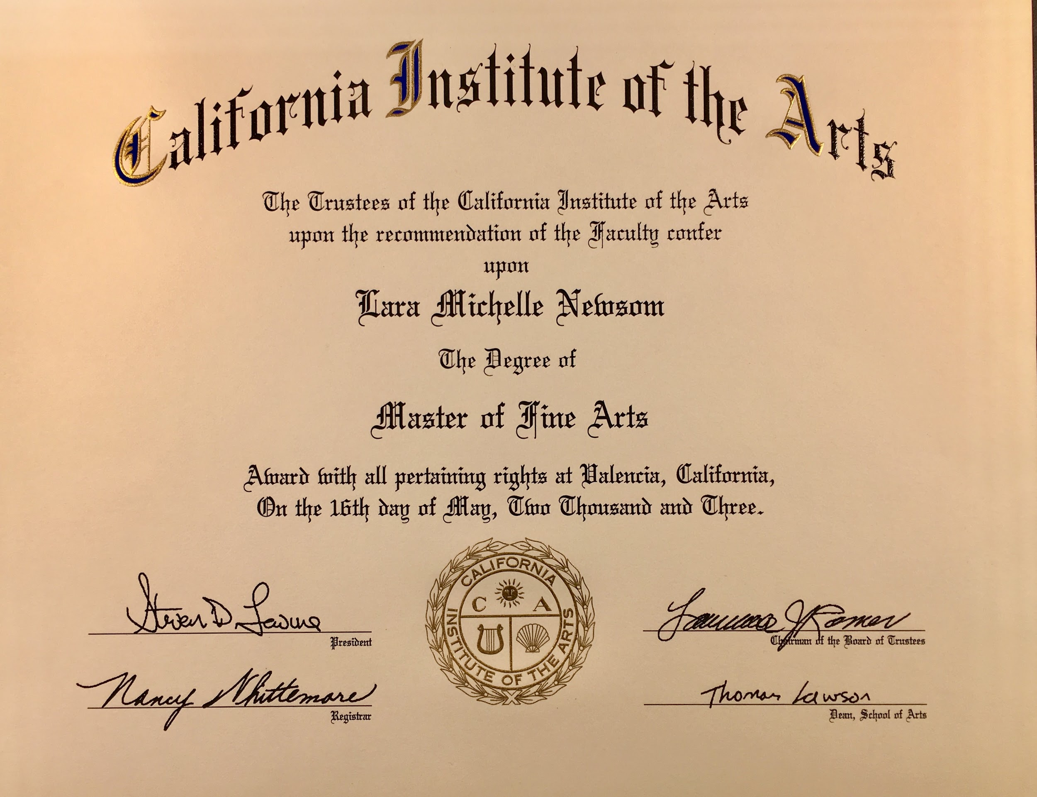

Slide 9







Slide 10




Slide 11


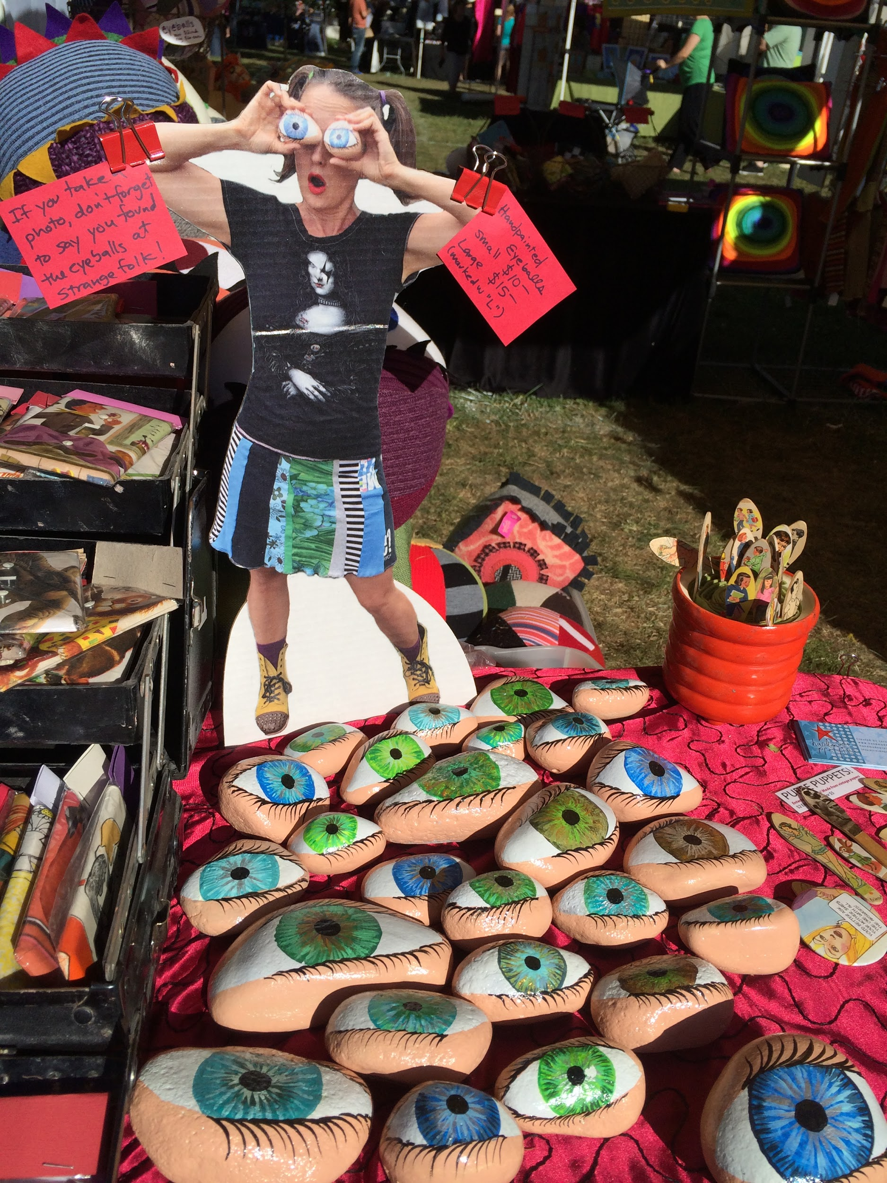

Slide 12


Slide 13
Starting Over Again Without Going Back to School… Again.

Slide 14
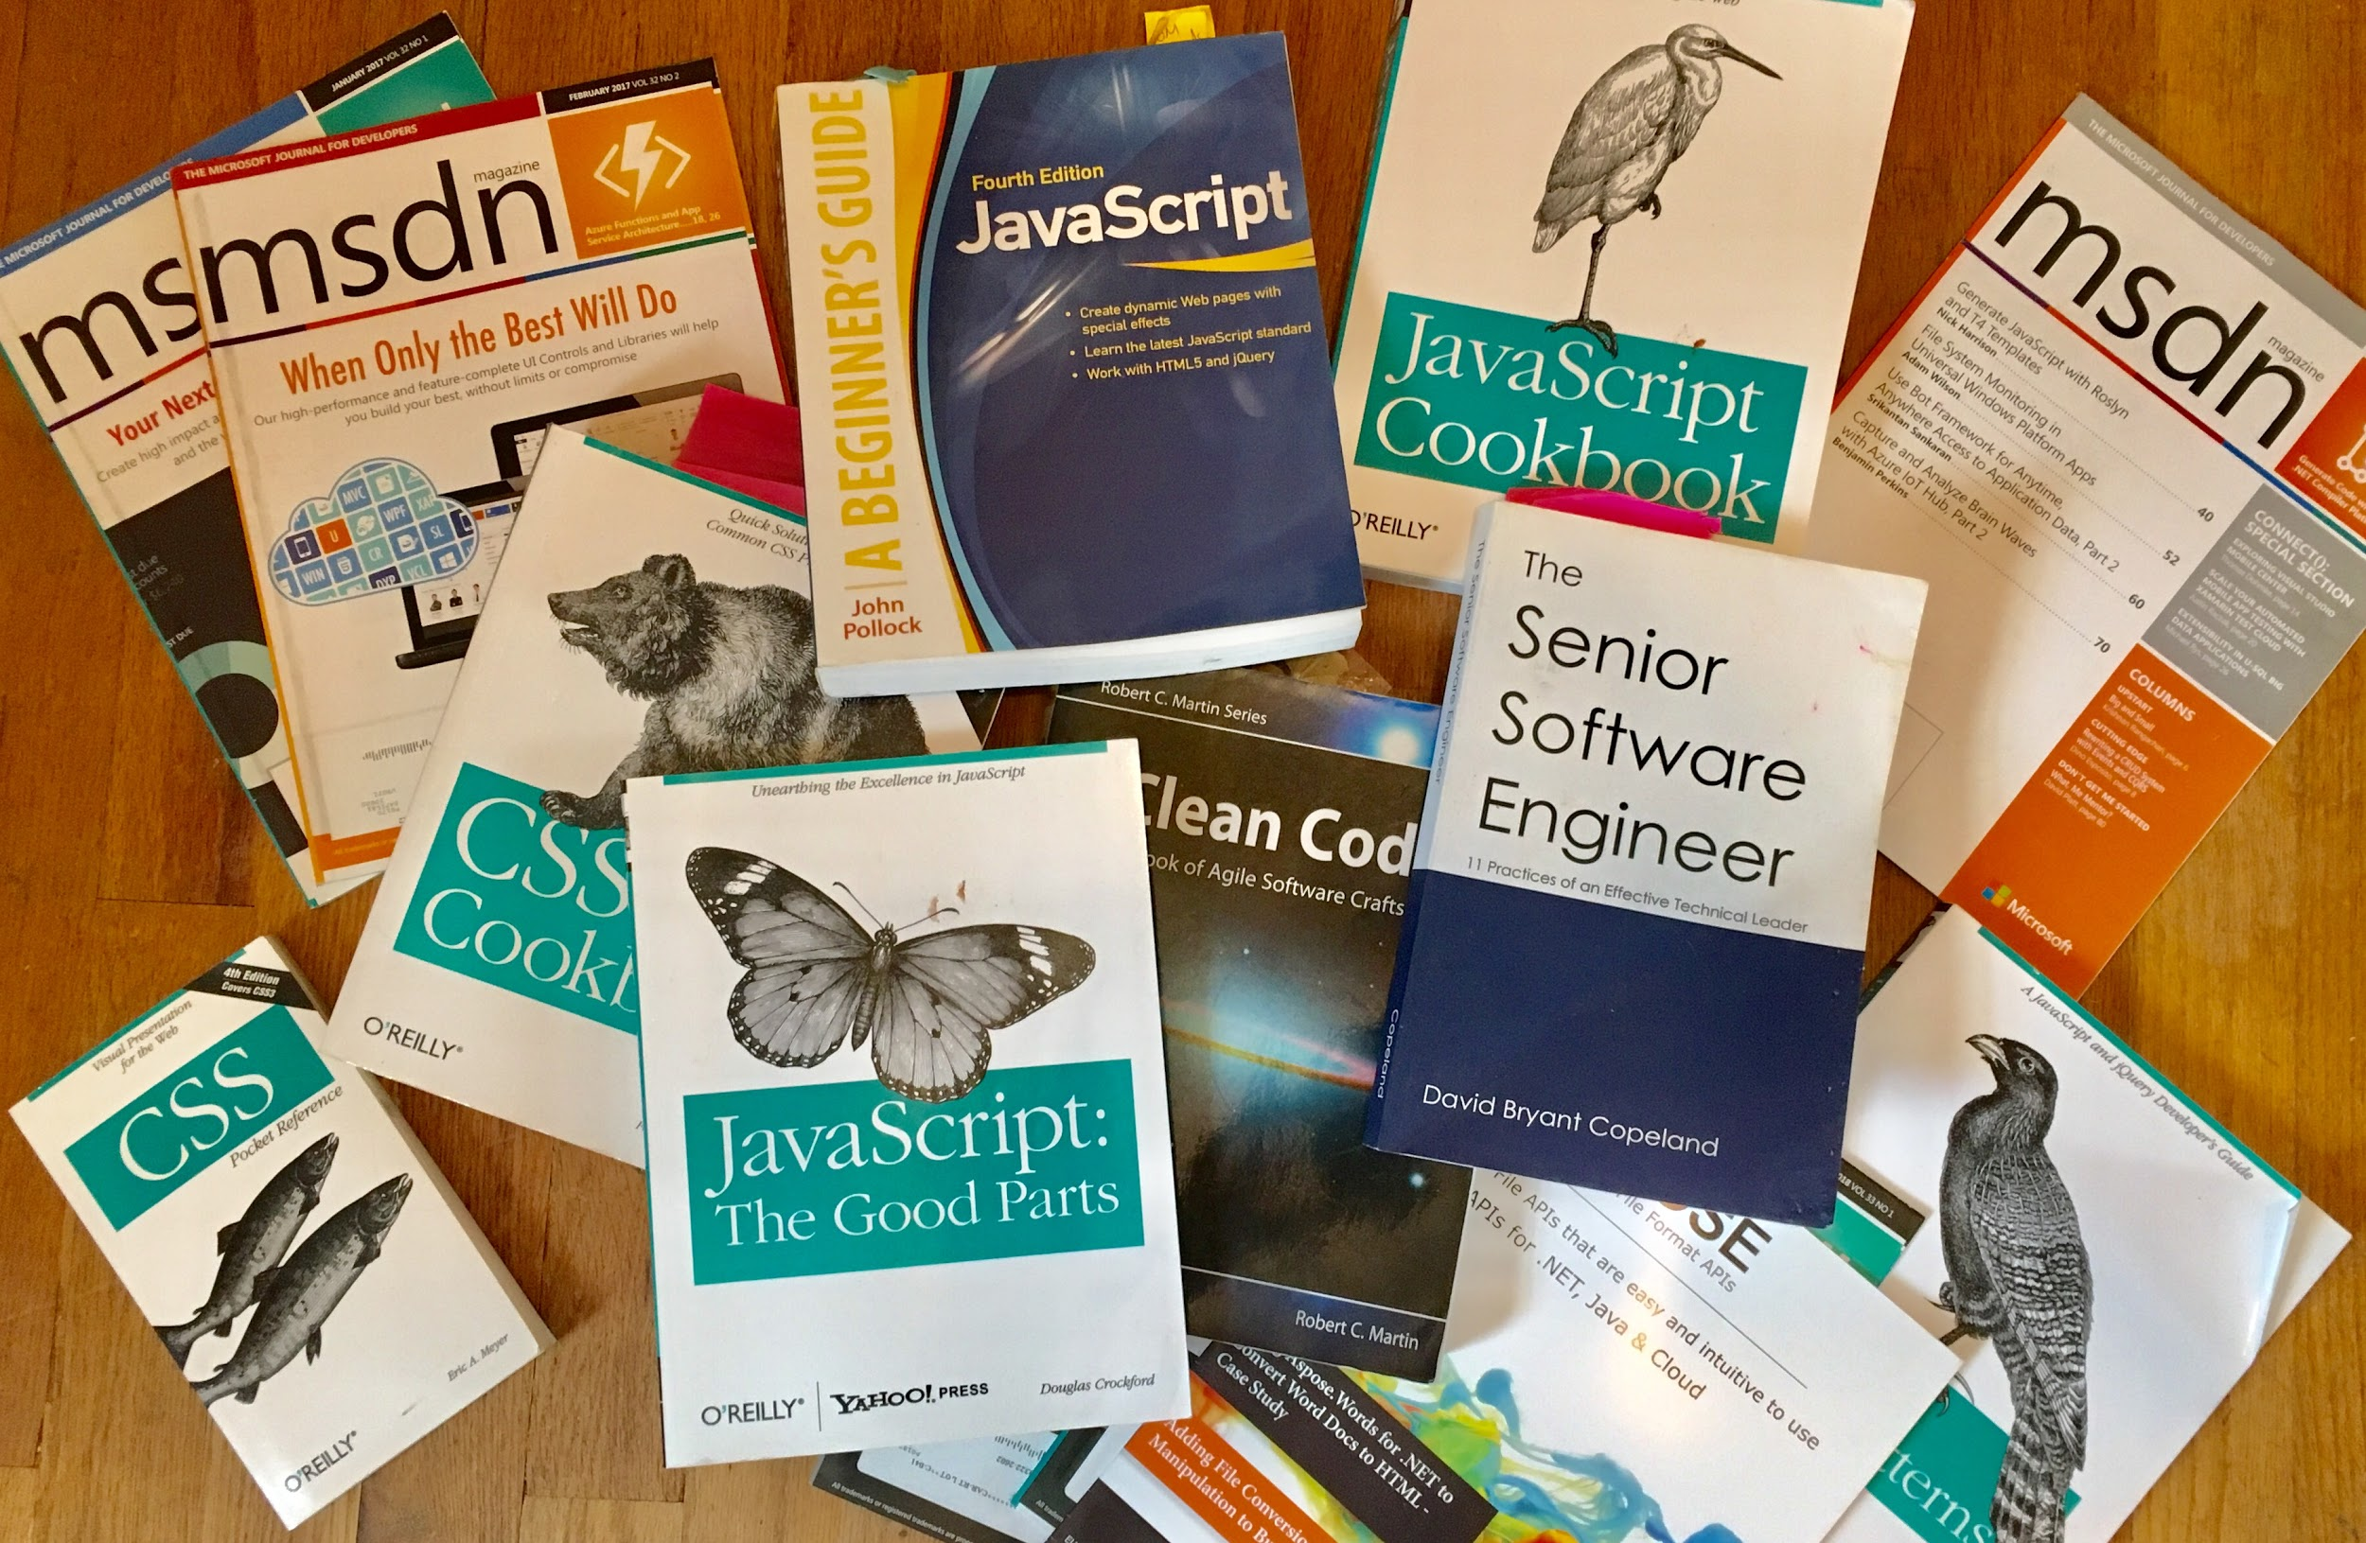

Slide 15
Google
A well phrased Google search can yield good answers, while vague or misdirected searches will yield nothing.
My biggest hurdle in learning how to code was learning how to refer to the parts of code.
Pay attention to the words used in accepted responses. Often they are more specific and when searched will give better results.
Now when I write answers to questions, I try to write them so that beginner me would be able to understand or find more information.
Google exact error messages
If all of your answers suggest a different library, language, or framework, you might need to rethink what you’re doing.
My first app was a pile of spaghetti code written in Visual Basic that I inherited from the previous developer. Every search yielded answers in C# that I translated to VB.

Slide 16
Read the docs
Some docs are better than others, but most will at least tell you what you can expect to get out of a method or type. Learning to leverage docs can save a lot of Google time.
Baeldung “Back to Basics” tutorial, and the docs in general.
RxJs docs have an Operator Decision Tree that will winnow down the exact operator to pipe to yield the results you want.
MDSN docs on Lists/Dictionaries/Arrays list all of the available methods for each type.
Some docs offer Tutorials to get you started
When learning how to test a framework, reference the docs first
Even if you opt for a different testing framework, the docs have clues to get it working

Slide 17
Dig Into the Source Code
Open source is awesome, and a lot of frameworks and libraries are open source.
Many libraries and frameworks are hosted on Github, fork the repo and dig into it!
For libraries that are not open source, specifically libraries that load files onto the client, you can often get some visibility into how the code works by downloading the code and unminifying it using a tool like Unminify
For libraries installed into your code, follow the classes back to their source definitions. (VS Code - F12). At minimum you can see if the class extends a known class or what dependencies it has.

Slide 18
Find a Video Tutorial/ Find a Blog
Most major frameworks are well represented on video tutorial sites like Pluralsight.
If you have an MSDN subscription through your client, you are eligible for a 6 month free subscription to Pluralsight.
If not wait for special pricing, they run $100 off specials all of the time.
Find blogs written by the actual developers working on a framework.
I find these by following podcasts and Tweets

Slide 19
Online Code Camps
Free Code Camp - free online coding boot camp
Code Wars - free online coding challenges
Hackerrank - The 30 day code challenges to learn new types and algorithms
Some resources to teach kids how to code are great at teaching anyone ho

Slide 20
Websites to teach kids (and adults) how to code
Code.org - website
CodeAcademy.Com - website
AppInventor.mit.edu - website
Crunchzilla.com - website
GetHopscotch.com - website
CodeMonkey.com - website

Slide 21
Make a Project
The hands down best way to truly learn and understand a new skill, is to practice.
Create a project that mimics scenarios you have encountered in previous jobs.
Volunteer for a Hack-A-Thon
Don’t be afraid to reach out for help or post questions on Stack Overflow
Don’t worry that you are writing perfect code. Refactoring exists for a reason.
My deepest understanding of how things work comes from digging in and hacking away until I can get something to work.
Once I get something working, I see how I can break it. Breaking code is illuminating when trying to understand exactly which dependencies do what.
Console Log, Debug, Step through everything to see what happens where.

Slide 22
Leverage Twitter and Social Media
Most modern frameworks and languages have official Twitter handles.
Once you’ve followed the framework/language/library, Twitter will suggest other people to follow. I check out their page to see what they are tweeting, if I find it useful I follow them
Follow Local Conferences and the speakers they tweet about
Conference speakers tend to go to several conferences a year. They will tweet about other conferences and other speakers.
Follow local meetups and local developers
Follow companies who are active in supporting the dev community
If you find one person particularly helpful, look at who they follow and follow the ones you find interesting.
It’s easy to unfollow or block people that get annoying.

Slide 23
Some of the People I follow on Twitter
@joshbloch - Java
@AdamBien - Java
@venkat_s - Java
@starbuxman - Java
@MitchelSellers - .Net
@Mattferderer - .Net
@davidpine7 - .Net
@aaronfrost - Angular
@josepheames - Angular
@DeborahKurata - Angular/.Net
@ladyleet - rxjs
@BenLesh - rxjs
@brian_d_vaughn - react
@troyHunt - security

Slide 24
Conferences
Conferences curate their sessions into topics relevant to what people want to learn. Follow the speakers on social media.
If you aren’t able to attend the conference, look at the schedule and see what topics are being presented. Look up the speaker and follow them on social media. Speakers will often link to their conference talks.
If you do attend, even if a session is over your head, write down words to look up later.
Talk to fellow attendees to learn about their experiences.
Talking to other attendees made me realize how much I had in common with them.
Talk to vendors. Pick up materials to research later
Some vendors send their actual devs to talk to people at conferences. And they are usually there because they are relevant in some way.

Slide 25
Conferences
Prairie.code() - Des Moines
No Fluff Just Stuff - Des Moines
DevUp - St Louis
Nebraska.code() - Omaha
Iowa Code Camp - DMACC FREE!
dsmAgile - Des Moines
That Conference - The Dells, WI
NgConf - Salt Lake City
RxJsLive - Las Vegas
NgDenver - Denver
StrangeLoop - St Louis
Connectaha - Omaha
React Conf - Las Vegas
NEJS Conf - Omaha
Code PaLOUsa - Louisville

Slide 26
Podcasts
Most major languages and some frameworks and libraries have podcasts dedicated to them.
Listening to podcasts gives exposure to the way people talk about the code which makes it easier to make efficient Google searches.
Many podcast guests will discuss where a framework is going or gotchas that keep people from adopting it.
Podcasts often announce upcoming conferences and events

Slide 27
Podcasts (I Listen To)
Adventures in Angular
Developer On Fire
Eat Sleep Code
JavaScript Jabber
Real Talk Javascript
Base.cs

Slide 28
User Groups and Meet Ups
User Groups are like free mini conferences.
Often the speakers at user groups give the same talks they have given at conferences.
They are often more intimate giving better access to the speakers for questions
This is a great place to network and meet local developers who share your interests
I literally wouldn’t have my job if it weren’t for the .Net Meetup group.
Have I mentioned they are FREE to attend?
However they are not free to produce, so be sure to RSVP and CANCEL your RSVP if you are not able to attend.

Slide 29
Ask Questions
Ask questions.
It can be really intimidating to ask questions, because it puts us in a vulnerable position. Being willing to be vulnerable opens a path to learning that is otherwise not available.
There are very few problems in software development that have not been encountered before.
Even senior developers reach out for difficult problems

Slide 30
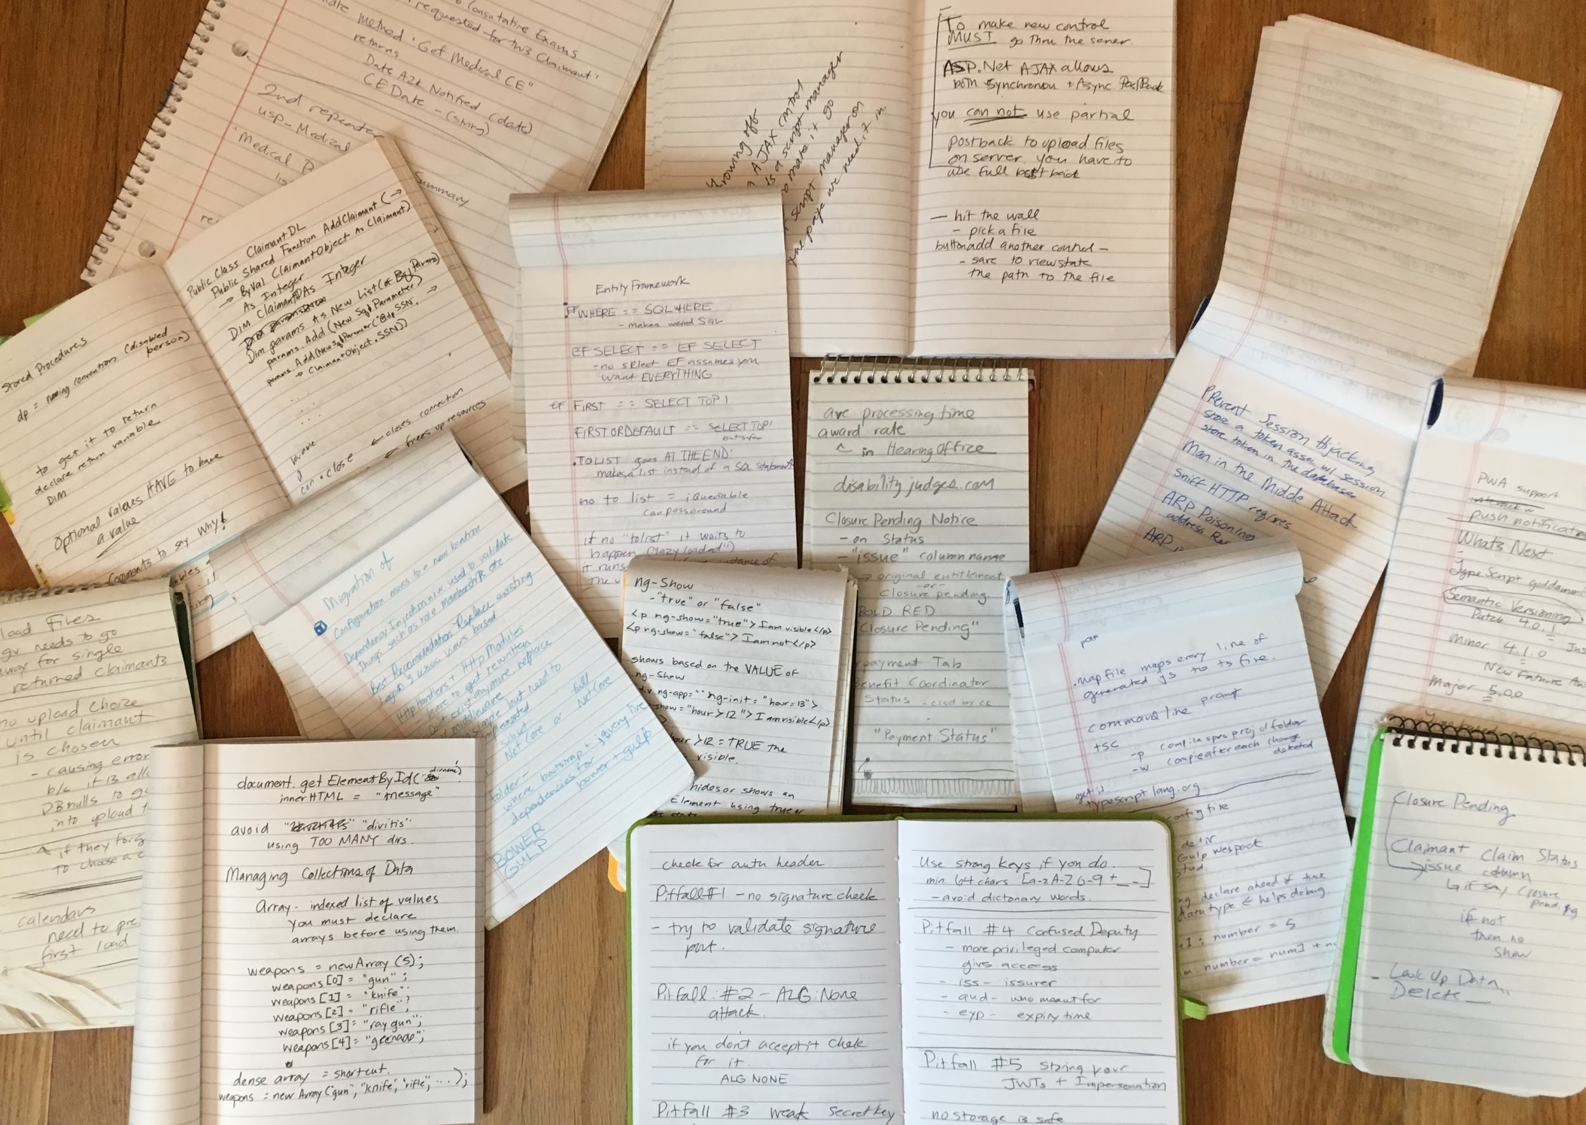

Slide 31
Take Notes
Take all the notes: during conferences, during user groups, during meetings.
Writing things down helps to remember them even if you never go back and read you notes.
People notice when you write things down. Clients notice.
Write down words, websites, libraries, websites, anything you want to look up later.
Take a few minutes after a conference or meeting to review those notes to bookmark websites or look up words.

Slide 32
User Groups
CIJUG
Web Geeks
dsmJS
Experiencing UX - Central Iowa
AWS Des Moines
Iowa .Net User Group
DevOps DSM
Des Moines Lady Dev
Follow the Source Allies #dsmtech Slack channel for daily updates!

Slide 33
Give Back to the Community
Answer questions on Stack Overflow
Share useful links with teammates
Do a tech leveling talk to share your new skills at work
Mentor a co-worker in learning a new skill
Speak at a conference or meetup
Start a user group
Write a blog post

